Slide 1
Algebra
Number
Data
Shape

Slide 2
Algebra Mains
Brackets
Two Brackets
Solving Equations
Collecting like terms
Simplifying
2 sided equations
Simultaneous equations
Solving simultaneous equations graphically
Factorising
Curved Graphs
Sequences
The Nth term
Quadratic Sequences
Substituting
Formulae
Quadratic Equation
Factorising Quadratics
Algebraic Fractions
Trial and Improvement
Inequalities
Laws of Indices
Parallel and Perpendicular lines
Finding the Gradient
Writing Expressions
Y=m x + c
Home

Slide 3
Shape Mains
Area of Circles
Circumference
Area of triangles
Circle theory 1
Circle theory 2
Construction
Sin and Cos
Sin, cos and tan
Sin, cos and tan 2
Sine rule
Cosine rule
Sine and cosine rules
Trig- missing angles
Pythagoras
Angles on a straight line
Angles on parallel lines
Angles in a triangle
Plans and Elevations
Perimeter
Worded Pythagoras
Reflection 1
Reflection 2
Translation
Rotation
3D Pythagoras
Home
Notes:
ago

Slide 4
Data Mains
Mean
Mean, mode, median and range
Median and range
Mean from tables
Mean from group tables
Tree Diagrams
Sampling
Mutually Exclusive Events
Listing Outcomes
Histograms
Cumulative frequency
Reading Pie charts
Drawing Pie Charts 1
Drawing Pie Charts 2
Drawing Bar Charts
Scatter Graphs
Box and Whisker plots
Sample Space Diagrams
The Probability Scale
Probability as Fractions
Stem and Leaf Diagrams
Relative Frequency
Reading Bar Charts
Home

Slide 5
Number Mains
Adding, subtracting decimals
BIDMAS
Adding and subtracting fractions
Direct Proportion
Factors
Factor Trees
Directed Numbers
Directed Numbers 2
Equivalent Fractions
FDP
Finding %
Ratio
HCF and LCM
Indirect Proportion
Limits
Multiplying and dividing decimals
Multiplying and Dividing Fractions
Multiples
Ordering Decimals
Ordering Fractions
Percentage Increase
Reverse Percentage
Rounding dp
Rounding sig fig
Standard form
Home

Slide 6
Adding and Subtracting Decimals
Home

Slide 7
Adding and Subtracting Fractions
Home

Slide 8
Adding and Subtracting Decimals
Home

Slide 9
Direct Proportion
If A is directly proportional to B, write an equation in the form A=kB linking the two variables if when A= 8 B= 4.
All of the variables below are directly proportional, write an equation linking them:
V= 12 when M =4
T= 5 when S=1
Y= 34 when x=2
H=48 when M=4
P= 5 when N=10
B is directly proportional to C, when B is 18 C is 27.
Write an equation linking B and C
Find B when C= 66
Find C when B = 30
Z is directly proportional to Y, when Z =55, Y=5
Write an equation linking Z and Y
Find Y when Z = 77
Find Z when Y=0.1
N is directly proportional to L, when N=1.8 L =0.6
Write an equation linking N and L
Find L when N= 3.2
Find N when L=0.5
Home

Slide 10
Bidmas
A)
(3 + 3 ) x 4
4 x 2 – 5
(5 + 7) ÷ 6
5 x 3 + 5
(9 – 4 ) + 5
1 + 1 – 1
2 x (15 – 2)
(5 x 4 ) + 2
(8 + 2 ) ÷ 10
(21 x 1 ) – 2
B)
(1 + 14) – (5 x 3 )
(10 + 6 ) ÷ (4 x 2)
(1 + 2 ) x (6 – 3)
(2 x 6 ) – (14 ÷ 2)
(7 x 2) ÷ ( 20 – 6)
(3 x 10) – (2 x 2)
(9 x 5) – ( 2 x 10)
C)
(3 x 3 – 4 ) x (2 + 2)
2 x (13 – 4) – (23 ÷ 23)
3 x (1 + 4) – (5 x 2)
4 x (3 + 2) – ( 24 – 5)
7 x ( 4 ÷ 2 ) ÷ ( 3 x 5 -1 )
((9 + 7 x 3 ) ÷ 10) – 1
Home

Slide 11
Factors and HCF
Find all the factors of the following numbers:
20
24
27
32
40
50
56
120
200
2 only has 2 factors (1 and 2), how many numbers can you find between 1 and 30 which have exactly 2 factors? (these are called prime numbers)
Find the highest common factors of the following pairs of numbers:
18 and 54
25 and 45
12 and 18
27 and 108
30 and 75
Find the HCF of these pairs of numbers:
90 and 450
96 and 480
39 and 195
Home

Slide 12
Factor Trees
Draw factor trees for the following numbers:
20
24
48
90
81
50
75
120
200
1800
2. Using your factor trees from question 1, write the numbers as products of their prime factors .
Home

Slide 13
Directed Numbers
Home

Slide 14
Directed Numbers 2
I am £250 into my overdraft (☹) but then I get paid £535, how much will I have in my bank account?
The temperature at the North Pole is -17°C; luckily the temperature in my living room is 40°C warmer than that, what is the temperature in my living room?
I have £32 and each month for 4 months I have to pay £15 to my mobile phone, if I don’t put any money into my account, how far will I be into my overdraft?
I jump out of a plane 125m above the ocean, I travelled 191m before I stop, how far am I from the surface of the water?
I am playing air hockey with my friend, because I am amazing I agree start on -9 points, we play first to 14, how many points do I need to score?
Home

Slide 15
Equivalent Fractions
Home

Slide 16
Ratio
There are 10 girls and 15 boys in a class, what is the ratio of girls to boys in its simplest form?
There are 14 cats and 16 dogs in an animal shelter, what is the ratio of cats to dogs in its simplest form?
There 22 caramels and 55 fudges in a bag of sweets, what is the ratio of caramels to fudges in its simplest form?
Simplify these ratio to their simplest forms:
48:60
45:75
63:108
25:40:80
24:56:96
120:180:600
320:400:440
Archie and Charlie share their Thomas the tank engine toys in the ratio 1:4, how many do they each get if they have:
10 toys b.30 toys c.45 toys
Tom and Jerry share sweets in the ratio 2:3, how many do they each get if they share:
20 sweets b.30 sweets c.55 sweets
Sue and Linda share some money in the ratio 3:7, how many do they each get if they share:
£30 b.£60 c.£90
Mike, Dave and Henry share some little bits of blue tack in the ratio 1:2:3, how many do they each get if they share:
60 pieces b.72 pieces c.300 pieces
Home

Slide 17
Finding Percentages
Some percentages I can find easily by doing a single sum, what single sums can I do to find:
10% b. 50% c.25%
If I know 10% how can I find:
5% b. 1% c. 20 % d. 90%
If I know 50% how can I find:
5% b. 25%
Find:
30% of 250 b. 40% of 500 c. 15% of 220 d. 75% of 84
Find:
35% of 440 b. 65% of 450 c. 16% of 220 d. 82% of 96
Find:
94% of 640 b. 8% of 520 c. 27% of 220 d. 53% of 96
Compare you methods for the questions above with a partner, where they the same ?
Home

Slide 18
Equivalent Fractions
Home

Slide 19
HCF and LCM
Find the Highest Common Factor of these numbers:
18 and 30
15 and 20
16 and 24
12 and 36
20 and 30
28 and 70
39 and 65
38 and 57
Find the Lowest Common Multiple of these numbers
6 and 7
4 and 6
5 and 8
10 and 4
16 and 5
14 and 21
2.2 and 5
0.4 and 7
Home

Slide 20
Indirect Proportion
If A is indirectly proportional to B and when A= 5 B= 6 :
Find k
Write an equation linking A and B
Find A when:
B=3
B=15
Find B when:
A=1
A=-3
If A is indirectly proportional to B and when A= 7 B= 12 :
Find k
Write an equation linking A and B
Find A when:
B=4
B=6
Find B when:
A=10
A=2
If A is indirectly proportional to B and when A= -4 B= 10 :
Find k
Write an equation linking A and B
Find A when:
B=-8
B=10
Find B when:
A=-1
A=-0.5
4. If A is indirectly proportional to B and when A= 24 B= 0.5 :
Find k
Write an equation linking A and B
Find A when:
B=6
B= -3
Find B when:
A= -2
A= 100
Home

Slide 21
Fractions, Decimals and Percentages
Home

Slide 22
Limits
These numbers have been rounded to the nearest 10, write down the largest and smallest values they could be:
50
80
110
These numbers have been rounded to the nearest whole number, write down the upper and lower limits:
3
17
23
100
-3
These lengths have been rounded to the nearest 10th of a cm, write the upper and lower limits:
12.5cm
21.7cm
35.8cm
52.1cm
80.4cm
4) A field is 100m wide and 120m long, both lengths have been rounded to the nearest metre.
a) Find the perimeter and area of the field if these measurements are accurate
b) Find the largest and smallest possible perimeter
c) Find the largest and smallest possible area.
5) A rectangle has it’s area rounded to the nearest whole number, it becomes 40cm². One side of the rectangle is exactly 10cm; find the maximum and minimum lengths the other length could have.
6) Two lengths of wood are stuck together and their combined length is rounded to the nearest mm and it is 14.9cm, one length is rounded to the nearest mm and is 7.1cm. Find the minimum and maximum length of the other length.
Home

Slide 23
Multiples
C. List 3 numbers which are in:
3 and 4 times tables
3 and 5 times tables
10 and 4 times tables
9 and 2 times tables
12 and 10 times tables
A. List the first 5 multiples of:
5
7
12
14
19
B. What is the:
9th multiple of 8
7th multiple of 6
12th multiple of 12
11th multiple of 10
13th multiple of 5
5th multiple of 13
D. What is the lowest common multiple of:
5 and 6
7 and 8
4 and 8
9 and 6
5 and 6
E. What is the lowest common multiple of:
13 and 5
15 and 12
16 and 10
14 and 21
21 and 70
Home

Slide 24
Multiplying and dividing fractions
Home

Slide 25
Multiplying and dividing decimals
Multiplying
Dividing
1
3.2 ÷ 4
4.8 ÷ 8
7.2 ÷ 9
2.4 ÷ 6
1.8 ÷ 3
2
5.6 ÷ 0.7
6.3 ÷ 0.7
2.7 ÷ 0.3
4.9 ÷ 0.7
2.8 ÷ 0.7
1.65 ÷ 0.15
÷ 0.12
27.3 ÷ 1.3
0.03 ÷ 0.005
0.99 ÷ 0.0009
1 | a) | 0.8 | x | 7 | =
 | b) | 0.5 | x | 7 | =
 | c) | 0.1 | x | 6 | =
 | d) | 0.6 | x | 4 | =
 | e) | 0.3 | x | 3 | =
2 | a) | 0.2 | x | 0.5 | =
 | b) | 0.4 | x | 0.7 | =
 | c) | 0.8 | x | 0.1 | =
 | d) | 0.9 | x | 0.9 | =
 | e) | 0.6 | x | 0.1 | =
3 | a) | 1.9 | x | 0.3 | =
 | b) | 1.6 | x | 0.5 | =
 | c) | 1.6 | x | 0.5 | =
 | d) | 1.7 | x | 0.2 | =
 | e) | 1.3 | x | 0.7 | =
4 | a) | 5.4 | x | 0.11 | =
 | b) | 5.2 | x | 0.97 | =
 | c) | 8.3 | x | 0.73 | =
 | d) | 4.6 | x | 0.11 | =
 | e) | 8.2 | x | 0.75 | =
Home

Slide 26
Ordering Fractions
Home

Slide 27
Ordering Decimals
For each pair of numbers say which is bigger by adding > or <.
0.2 0.7
0.3 0.1
0.7 0.9
0.3 0.4
0.6 0.3
0.24 0.2
0.3 0.39
0.4 0.35
0.9 0.85
0.22 0.3
Try these:
0.04 0.05
0.02 0.09
0.12 0.02
0.04 0.23
0.4 0.04
3. These are trickier:
2.34 0.09
4.49 4.0003
5.01 5.1
6.32 6.325
7.436 7.43
8.35 8.345
4. Put these decimals in ascending order (smallest to biggest):
a. 0.2 0.3 0.15
b. 0.7 0.64 0.072
c. 0.85 0.9 0.425
d. 0.734 0.7345 0.7335
e. 6.234 6.009 6.4
Home

Slide 28
Percentage Increase
Explain how you would use a calculator to increase an amount by a given percent.
Increase the following amounts by 42%
£225
£306
£125
£448
£512
A TV costs £120, how much will it cost if its price is increased by:
12%
31%
55%
62.5%
99.9%
Simon puts £70 in a bank, each year the money in his bank increase by 5.5%, how much does he have in:
1 year
2 years
5 years?
Explain how you would use a calculator to decrease an amount by a given percent.
Decrease the following amounts by 28%
£225
£306
£125
£448
£512
A TV costs £120, how much will it cost if its price is decreased by:
19%
32%
79%
73.5%
42%
A car bought for £6, 500 depreciates in value by 12.5% each year, how much will it be worth after:
1 year
2 years
5 years?
Home

Slide 29
Rounding to Significant Figures
Home

Slide 30
Rounding to Decimal Places
Round the following numbers to a) 1 decimal place b) 2 decimals places c) 3 decimal places
a) 1.463884266
b) 1.572660902
c) 3.783345228
d) 6.3931313
e) 0.640368898
f) 0.326119942
g) 4.249504359
h) 4.44692939
i) 1.447852851
j) 0.069143754
Work out the following on a calculator and give the answer to 2 decimal places; 3.104 x 5.938 2.99 x 8.82 7.1537÷ 3.111 14.77²
Home

Slide 31
Reverse Percentages
What would you multiply an amount by to increase it by:
15%
25%
4%
0.5%
13.5%
Find the original prices of these prices that have been increased by the given percentage:
Cost= £49.5 after 10% increase
Cost= £74.75 after 15% increase
Cost= £61 after 22% increase
Cost= £104 after 30% increase
Cost= £120 after 50% increase
I have £252 in my bank account; this is due to me earning 5% interest on what I originally had put in. How much money did I have originally in my bank account?
4. What would you multiply an amount by to decrease it by:
15%
25%
4%
0.5%
13.5%
5. Find the original prices of these items that have been decreased by the given percentage:
Cost= £72 after 10% decrease
Cost= £93.5 after 15% decrease
Cost= £42.5 after 35% decrease
Cost= £4 after 40% decrease
Cost= £67.50 after 55% decrease
6. A Cars value has dropped by 11.5% it is now worth £3053.25, what was it worth when it was new?
Home

Slide 32
Standard Form
Home

Slide 33
Two Brackets
Home

Slide 34
Two sided linear equations
Solve these equations:
85-3x = 49
45 + 2x = 79
52 – 8x= 20
101 – 9x = 29
71 – 11x = 38
Find x
2x + 4 = 3x + 1
10x + 8 = 4x + 38
7x – 3 = 3x +25
11x + 5= 9x + 21
4 + 11x = x + 9
Solve these equations by multiplying out brackets and simplifying:
3(x +2) + 5(x-1)= 25
2(2x + 1) + 6(x + 3)= 70
4(3x + 3) – (x + 5)= 106
Solve these equations
2(3x+4)= 2(4x-1)
2(3x-4)= 4(x + 3)
4(3x + 2) = 8(2x -1)
Home

Slide 35
Algebraic Fractions
Home

Slide 36
Brackets
Remove the brackets from these expression by multiply them out:
2(x +5)
6(2x +7)
8(4x -2)
5(3x -9)
2(4 -2x)
8(3 – 4x)
x(x + 3)
x(2x +9)
x(4x -7)
2x(9 -5x)
Multiply out the brackets:
x(3x² + 5)
2x(5x² + 6)
5x(3x³ - 7)
Multiply out the brackets and simplify:
3(x + 4) + 4(x-6)
7(x + 7) + 5(2x-8)
3(4x + 1) + 2(6x-9)
5(5x - 4) - 4(3x-6)
2(13 -x4) - 9(x+ 6)
Home

Slide 37
Collecting like terms
Simplify
10a + 4a
2b + 7b
3a + a + 4a
11b – 4b
14b – 5b + 4b
3a – 6a + a
Simplify
10a + 4b –a +5b
8a + 5a +5b – 3b
12b – 7a + 3b +a
2b – 8b –a + 9a
-13b + 4a -5b -4a
11a + 8b + 2c + 6a + 3b -2c
6b + 4b –a +6c + 5a – 4c
7c + 4b- 3b + a + 10c – 5a
10a + 4b + 7a + 10b – 17a – 14b
5b + 4c + 18c – 22a + z
Home

Slide 38
Curved Graphs
Home

Slide 39
Factorising
A) Factorise the following completely:
10A + 15
24A + 36
16A - 64
15B² + 20B
14B² + 49B
9B² + 72B
33B² - 44B
2C³ + 8C
5C⁴ + 40C
10C³ + 8C
B) Factorise the following completely:
9AB + 6A
16AB – 4B
30A²B + 24AB
10AB² – 15B²
12ABC + 20 AB
28A²BC + 14ABC
4AB – 8A + 16B
15A – 18B – 21AB
9B³ + 18BC + 30AB
ABC-10AB +AB
Home

Slide 40
Finding the gradient
1) Find the gradient between the points:
(3,5) and (4,7)
(5,9) and (7,17)
(4,6) and (5,7)
(1,4) and (4,19)
(0,11) and (4,23)
2) Find the gradient between these points:
(2,5) and (3,-3)
(2,8) and (3,2)
(4,8) and (4,8)
(8,15) and (6,33)
(7,12) and (4,42)
(4,8) and (3,14)
Find the gradient between these points:
(3,5) and (4,5.5)
(5,9) and (7,8)
(4,6) and (5,6.75)
(1,4) and (4,4.75
(0,11) and (4,11.4)
Home

Slide 41
Formulae
A) Isaac Newton’s second law of motion states F=ma (force= mass x acceleration)
Find F if:
M=10 and a=5
M=12 and a=12
M=0.5 and a=11
Find a if:
F=100 and M=20
Find m if:
F=36 and a=12
B) Density equal volume divided by mass
Write a formula for density
Find D if
M=10 and v= 40
M=12 and v=72
M=5 and v=90
Find M if:
D=4 and v=52
Find v if:
D=8 and m=11
C) Electrical power (p) is equal to voltage (V) squared divided by resistance (r)
Write a formula for power
Find p if:
V= 4 and r=8
V=9 and r=3
Find r if:
P=16 and v=8
Find v if:
P=20 and r=5
Home

Slide 42
Inequalities
Home

Slide 43
Laws of indices
Simplify:
A² x A
A⁴ x A²
A⁸ x A²
3A⁹ x A³
4A² x 5A¹
Simplify:
A¹⁰ ÷ A
A²¹ ÷ A⁷
A²⁰ ÷ A⁴
9A¹²÷ 3A⁶
12A⁶ ÷ 4A⁴
Simplify:
(A²)⁴
(A³)³
(A²)⁶
(2A⁹)²
(3A⁴)³
Simplify:
A⁰
B⁰
99⁰
52⁰
0.061⁰
Simplify:
A⁻⁴
A⁻⁶
A⁻²
2A⁻⁴
9A⁻³
Simplify fully:
25A⁴ ÷ 5A⁷
3A⁹ x 2A⁻³
(A²)⁶ x (2A²)²
(2A³)⁸ ÷ (2A⁴)⁶
(A²)⁻⁶
Home

Slide 44
Parallel and Perpendicular lines
Home

Slide 45
Quadratic sequences
Home

Slide 46
The quadratic equation
For each of these equations, what is a, b and c? (the first one has been done for you)
2x²+4x -3 =0 a=2 b=4 c=-3
6x²+x - 10=0
x²-4x -5=0
2x²-10x + 7=0
0.5x²+8x + 2=0
Use your answers from question one to find the possible values for x.
Rearrange these equations to the form ax² + bx + c =0, then solve with the quadratic equation:
2x²+ 9x -2 =10
4x + 5x² - 10=2
x² + 5x -3=x
2x²-10x - 2= x²
3x² + 6 + 2x =8 + 7x
Home

Slide 47
Factorising Quadratics
Factorise and solve:
X² + 8X + 12= 0
X² + 7X + 10= 0
X² + 13X + 12= 0
X² + 19X + 70=0
X² + X – 20=0
X² - 4X- 12=0
X² - 12X + 20=0
Rearrange, factorise and solve
X² + 21X + 32=12
X² + 8X -5 = -20
X² + 6X + 23 = 5 – 3X
Solve
3X² + 21X + 51=15
2X² +18 + 10=-6
4X² -8X -4= 36 + 4x
Home

Slide 48
Sequences
Copy down the following sequences and add the next three terms:
3 6 9 12 15
2 7 12 17 22
4 10 16 22 28
13 24 35 46 57
50 48 46 44 42
For each of the questions in question what is rule to find the next term in the sequence. (This is called the term to term rule)
Copy the following sequences, write the term to term rule and find the next 3 terms.
0.3 0.7 1.1 1.5 1.9
1.4 1.7 2 2.3 2.6
40 39.5 39 38.5 38
5.9 5.3 4.7 4.1 3.5
11.4 12.5 13.6 14.7 15.8
Copy the following sequences, write the term to term rule and find the next 3 terms.
5 0 -5 -10 -15
3 -1 -5 -9 -13
-20 -16 -12 -8 -4
-30 -27.5 -25 -22.5 -20
Copy the following sequences, write the term to term rule and find the next 3 terms.
1 2 4 8 16
1 3 6 10 15
1 3 7 13 21
Home

Slide 49
The Nth term
1) Find the nth term of the following sequences:
4 7 10 13 16
2 7 12 17 22
4 10 16 22 28
13 24 35 46 57
1 9 17 25 33
2) Take the following nth terms and find the first 5 terms
3n + 1
4n +2
5n + 5
4n – 1
6n + 3
10n -3
3) If the nth term is 7n + 4 what is
The 4th term b. The 12th term c. The 100th term
4) If the nth term is 8n - 2 what is
The 4th term b. The 12th term c. The 100th term
5) If the nth term is 11n + 3 what is
The 4th term b. The 12th term c. The 100th term
6) If the nth term is n + 9 what is
The 4th term b. The 12th term c. The 100th term
Home

Slide 50
Simplifying Expressions
Home

Slide 51
Simultaneous Equations
Find a and b for each pair of simultaneous equations:
5a + 2b= 14 6a + 2b= 16
7a + 3b= 27 6a + 3b= 24
10a - 2b= 30 3a - 2b= 2
9a - 6b= 42 6a - 6b= 18
Find a and b for each pair of simultaneous equations:
4a + 7b= 27 4a - 7b= 13
3a + 2b= 35 2a - 2b= 10
11a - 8b= 4 a + 8b= 44
5a + 3b= 69 7a - 3b= 75
Find a and b for each pair of simultaneous equations:
5a + 6b= 28 6a + 2b= 18
4a + 4b= 36 6a - 2b= 22
2a - 8b= 14 3a + 2b= 41
9a + 6b= 84 3a - 3b= 25.5
Home

Slide 52
Solving Simultaneous Equations Graphically
Home

Slide 53
Solving Equations
Find x if:
7x= 42
12x=36
5x = 40
10x = 110
How did you answer these questions?
Find x if:
X + 10 = 17
X + 15 = 27
X + 25 = 30
X- 9 = 15
X – 13 = 40
How did you answer these questions?
Find x if
3x + 6 =21
7x + 11 = 67
5x + 4 = 24
9x – 2 =25
11x – 14= 30
10x - 7= 53
12x + 11= 155
15x - 14= 61
13x + 25 = 90
How did you answer these questions?
Home

Slide 54
Substituting
If A is 5 what is:
5A
11A
6A – 10
9A + 15
100-5A
If B is 7 what is
2(B+8)
3(B-5)
B(B+5)
9(10-B)
(3+B)X(B-5)
If A= 6 and B=7 what is:
A+B
B-A
6A+2B
AB
A(B+1)
A²B
Home

Slide 55
Trial and Improvement
Use trial and improvement to find the positive solution to these quadratic equations to 1 dp, you may like to use a table, the table for the first question has been drawn for you.
X² + 3x -30=0
X² + 3x -30=0
X² + 2x -20=0
X² + 4x -10=0
X² -2x -5=0
Use trial and improvement to find the positive solution to these quadratic equations to 2dp
3X² - 5x -10=0
2X² + 2x -25=0
Use trial and improvement to find the positive solution to these quadratic equations to 3dp
X² + x -6=0
3X² - 2x -11=0
x | X² | +3x | -30 | Big or small?
Home

Slide 56
Writing Expressions
My age is C, write expressions for the ages of the members of my family if:
My brother is 3 years older than me
My sister is 2 years younger than me
My mum is double my age
My dad is 5 years older than my mum
My Gran is 4 times my age
My Grand Dad is twice my Dads age
If I have S sweets, write an expression for the number of sweets my friends have if I:
I give Tom all my sweets and he has 5 of his own
I give Alan half of my sweets
I eat four sweets then give Simon the rest
I give Lucy a quarter of my sweets, then an extra 1
My favourite song last M minutes, how long do I spend listening to music if:
I listen to the song once and hour all day (and including when I’m asleep)
I listen to half the song 8 times
I listen to the intro (a quarter of the song) 5 times
I listen to my song, then the next one which is exactly twice as long
I listen to my song, then the next one which is exactly twice as long, and do this 5 times throughout the day
If a rectangle has lengths x and y, write an expression for:
The area of the rectangle
The area covered by 6 rectangles
The perimeter of the rectangle
Home

Slide 57
Y=mx +c
Copy and complete:
A line with a positive gradient will go from ________ left to ________right
A line with a negative gradient will go from ________ left to ________right
Look at the equations below, write down the gradient and the coordinates of the line they represent.
Y=3x+4
Y= 2x-5
Y=6x+9
Y=x- 7
Y=10x
Y=5+8x
Y=7-11x
Draw an axis from -10 to 10, plot the following lines
Y = 2x + 3
Y = 3x – 2
Y = -2x + 5
Y = -3x + 9
Find the gradient of the line between these pairs of coordinates by dividing the change in y by the change in x.
(3,3) (5,5)
(5,5) (6,7)
(1,2) (3,8)
(10,9) (6,1)
(15,20) (10,5)
Using the gradient worked out in the last question and one of the coordinates, find the value of c for the line between the pairs of points in question 4.
Write out the equation of the line between the pairs of points in question 4 in the form y=mx+c
Home

Slide 58
Area of Circles
Home

Slide 59
Area of Triangles
1. Find the area of the triangles on the left
2. Find the missing lengths of the triangles on the right
Home

Slide 60
Circumference
Home

Slide 61
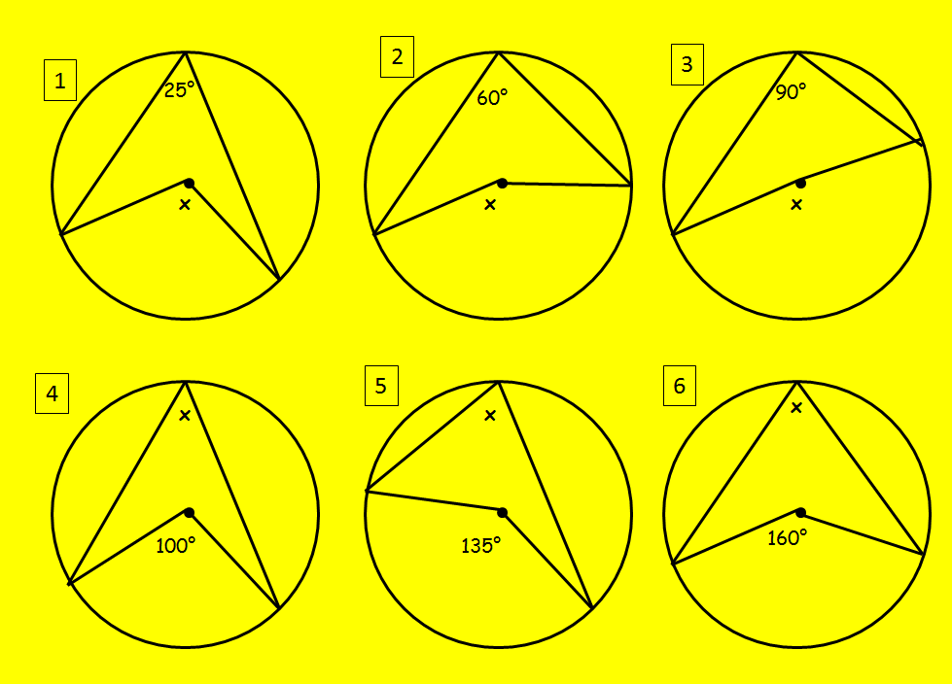
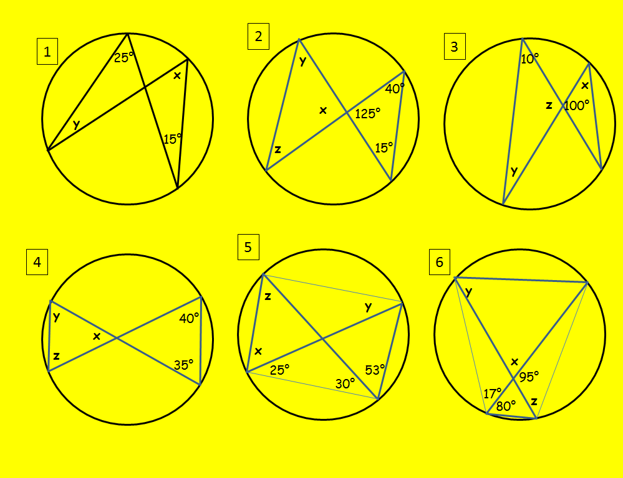
Circle theory 1
Home

Slide 62
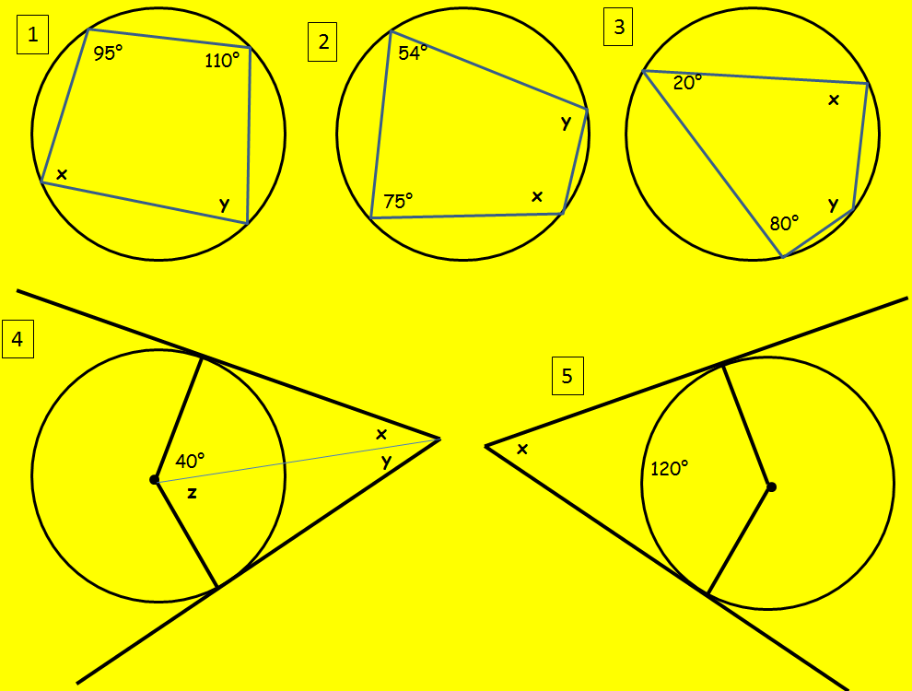
Circle Theory 2
Home

Slide 63
Construction
Home

Slide 64
Trigonometry- Sin and Cos
Home

Slide 65
Trigonometry- finding angles
Home

Slide 66
Trigonometry- Sin, Cos and Tan
Home

Slide 67
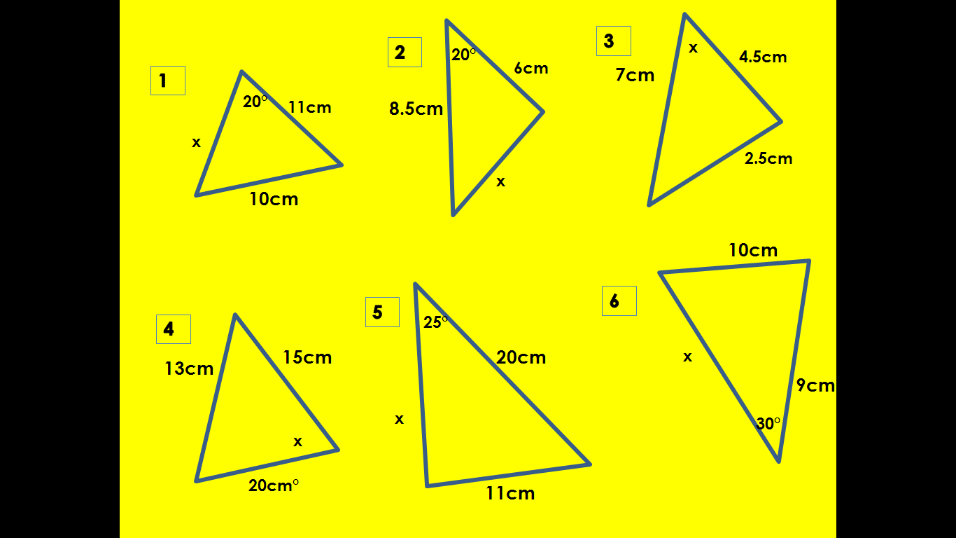
Cosine rule
Home

Slide 68
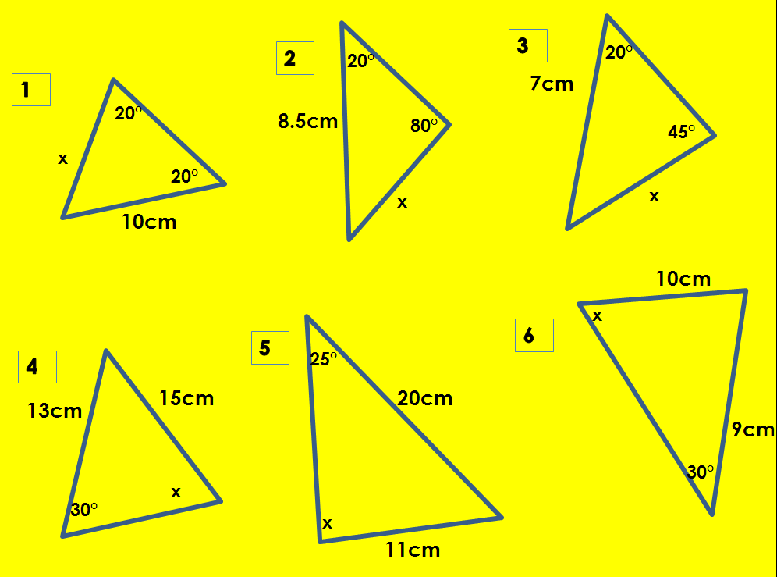
Sine rule
Home

Slide 69
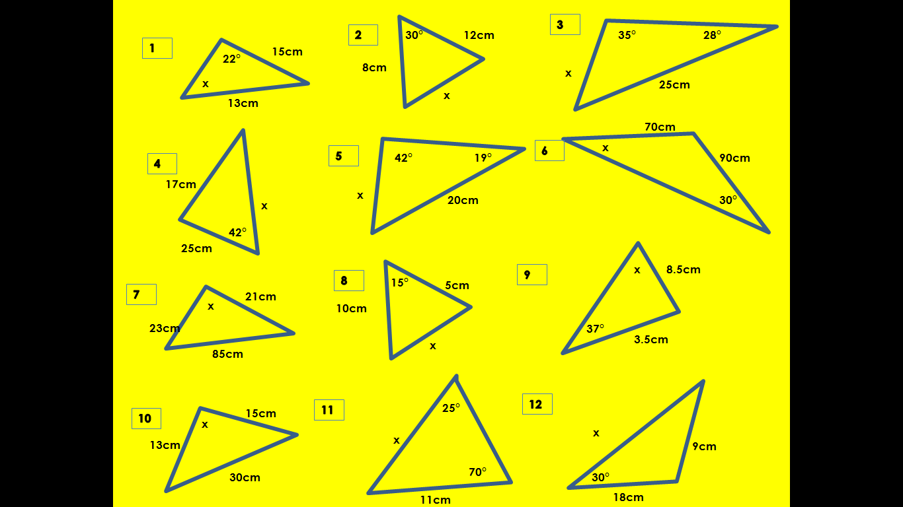
Sine and Cosine Rule
Home

Slide 70
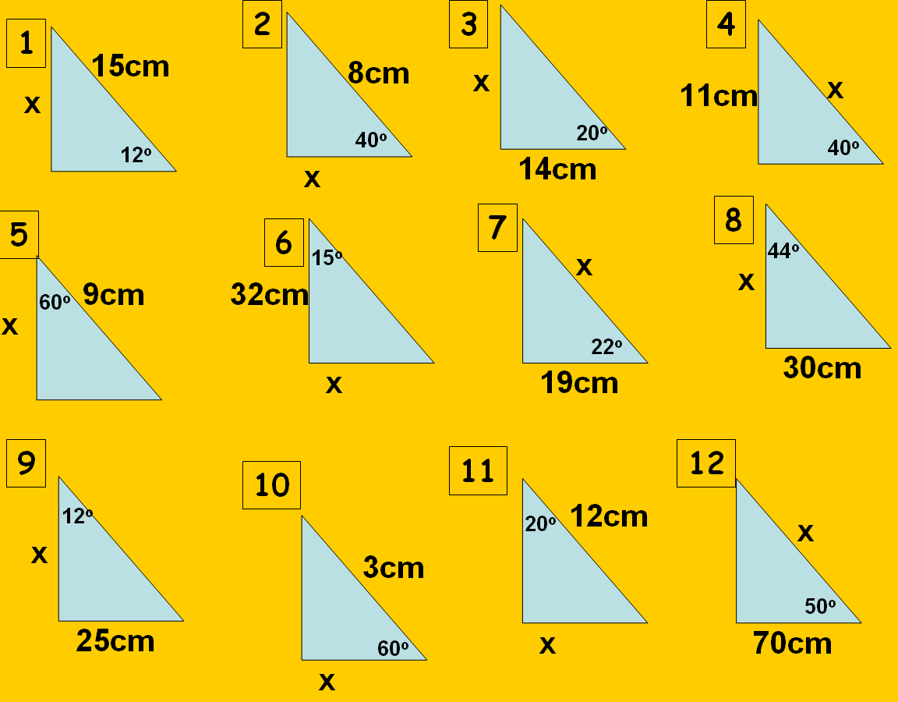
Sin, cos and tan 2
Home

Slide 71
Translation
Home

Slide 72
Reflection 2
Home

Slide 73
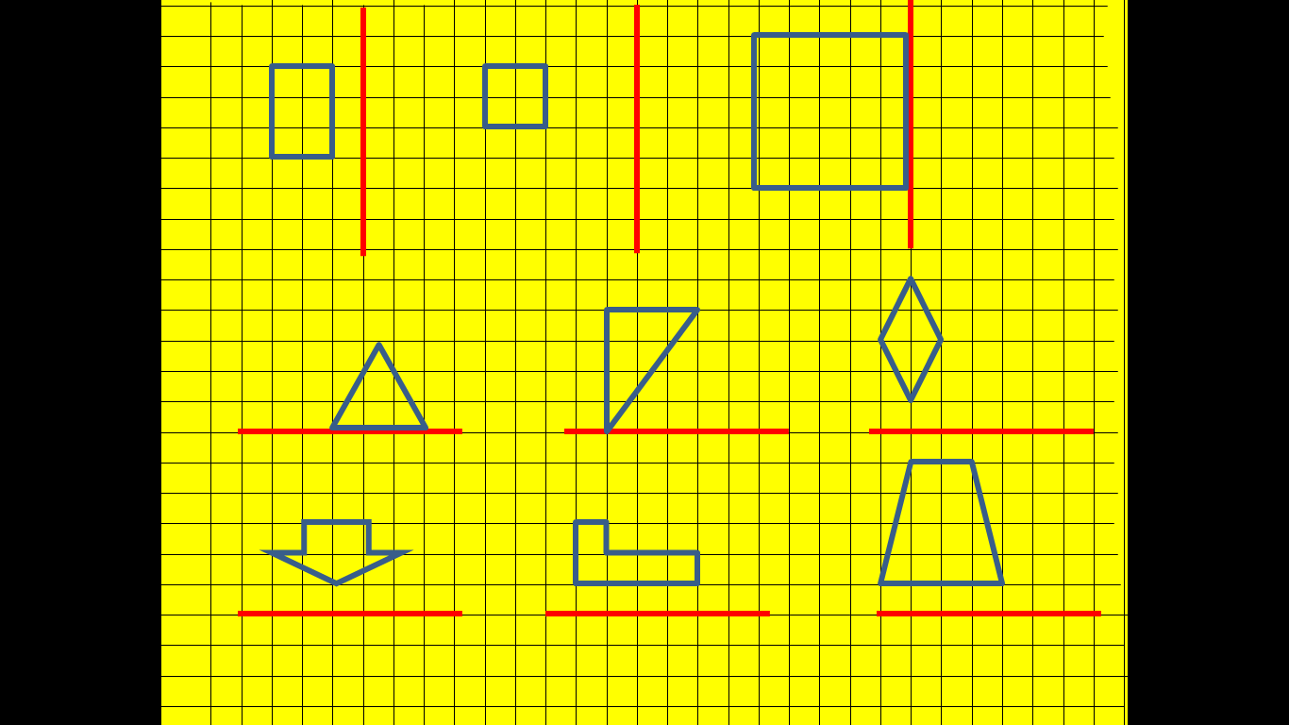
Reflection 1
Reflect these shapes in the mirror lines
Home

Slide 74
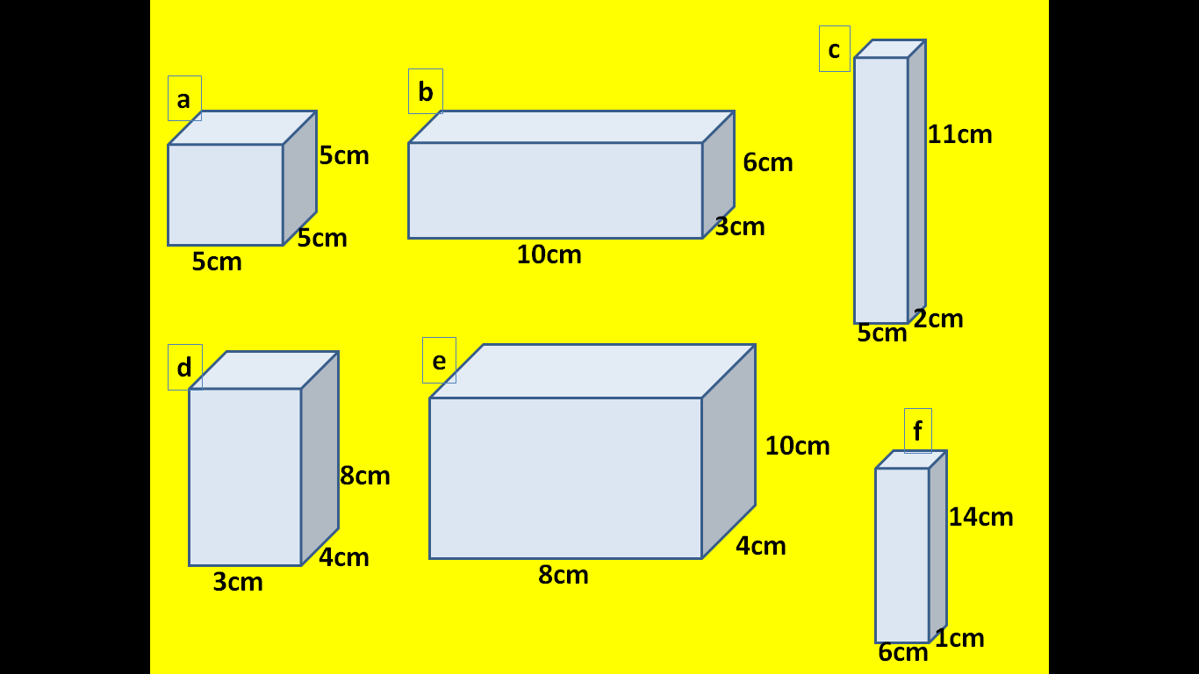
3D Pythagoras
Find the length of the longest diagonal of these cuboids
Home

Slide 75
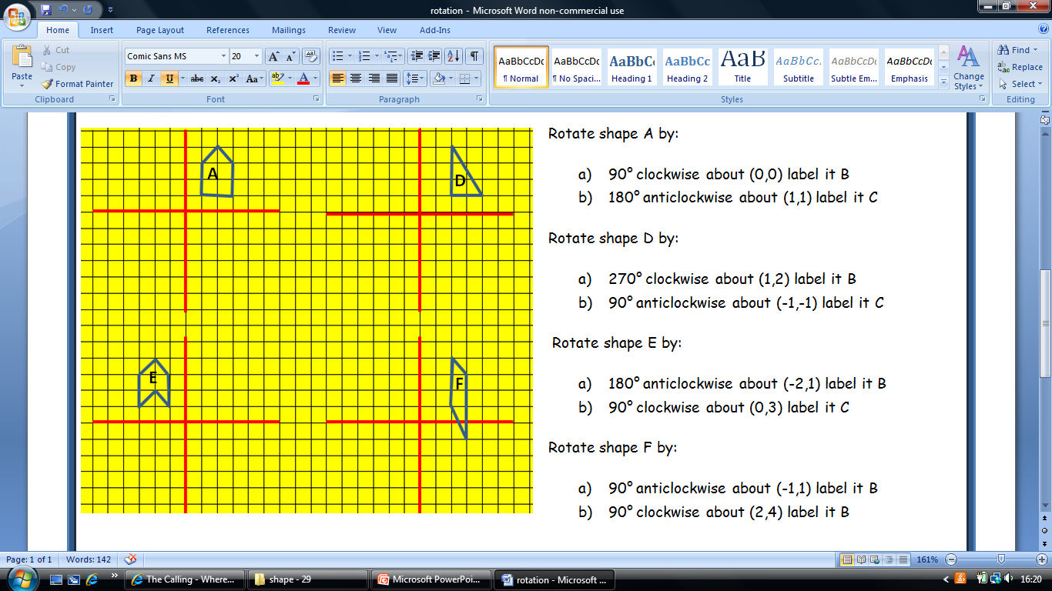
Rotation
Home

Slide 76
Perimeter
Home

Slide 77
Worded Pythagoras
A hunter fires an arrow to kill a bird, the bird falls 20m and the hunter has to walk 40m to pick it up, how far did the arrow travel to the bird?
A boat travels 45 miles east then 60 miles north, how far is it from where it started?
A swimming pool is 25m by 12m, if someone swam from one corner to the other, how far would they have swum?
A kite is flying on a string which is 10m, the kite is flying 6m of the ground, if the kite plummets straight down how far will the kite flyer have to walk to pick it up?
A totem pole is tied to the ground with ropes stuck in the ground with pegs, if the rope is 14m long and the pole is 9m long, how far will the pegs be from the base of the totem pole?
A fly is 1m of the ground and 70cm away from a chameleon, the chameleon s tongue flies out a catches the fly, how long is the chameleon’s tongue?
A lighthouse shine a light on a ship, the light beam is 80m long, the ship is 110m away from the base of the lighthouse, how tall is the lighthouse?
A man falls from the top mountain, he travels 2.5km and the mountain is 1.7km, how far has he travelled horizontally?
A helicopter floats 120m above a helipad, a dog is 85m from the helipad, if the dog could fly, how far would it have to fly to get to helicopter?
Home

Slide 78
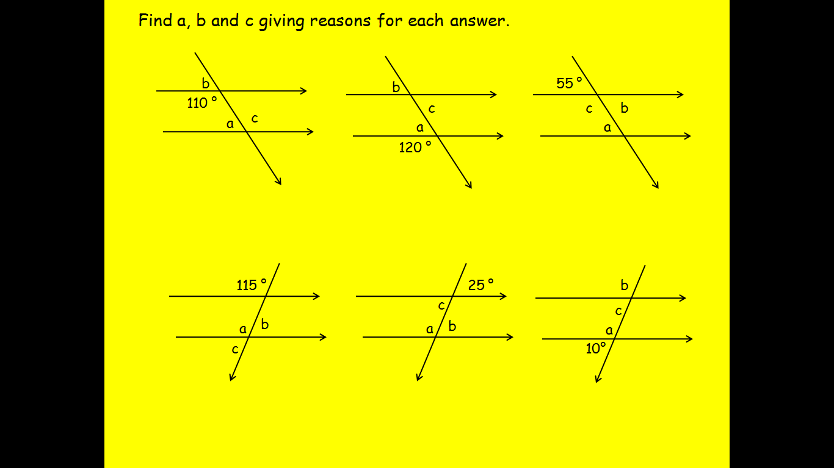
Angles on parallel lines
Home

Slide 79
Angles on a straight line
Home

Slide 80
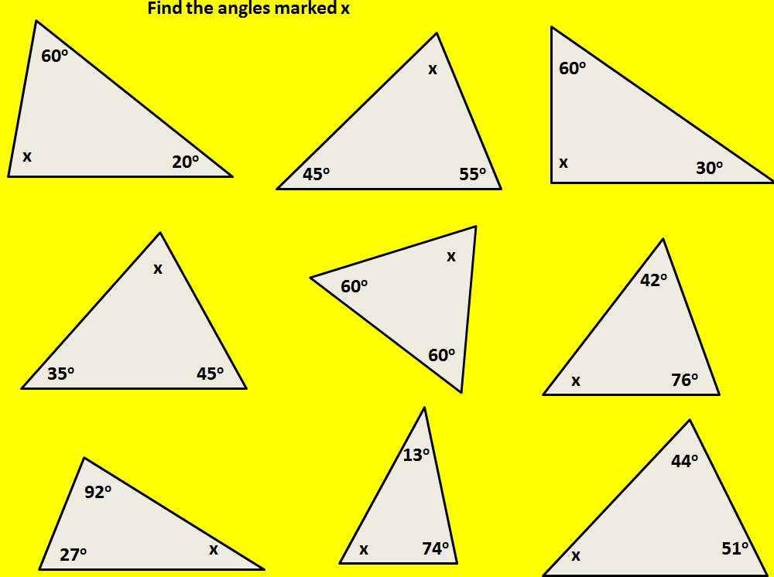
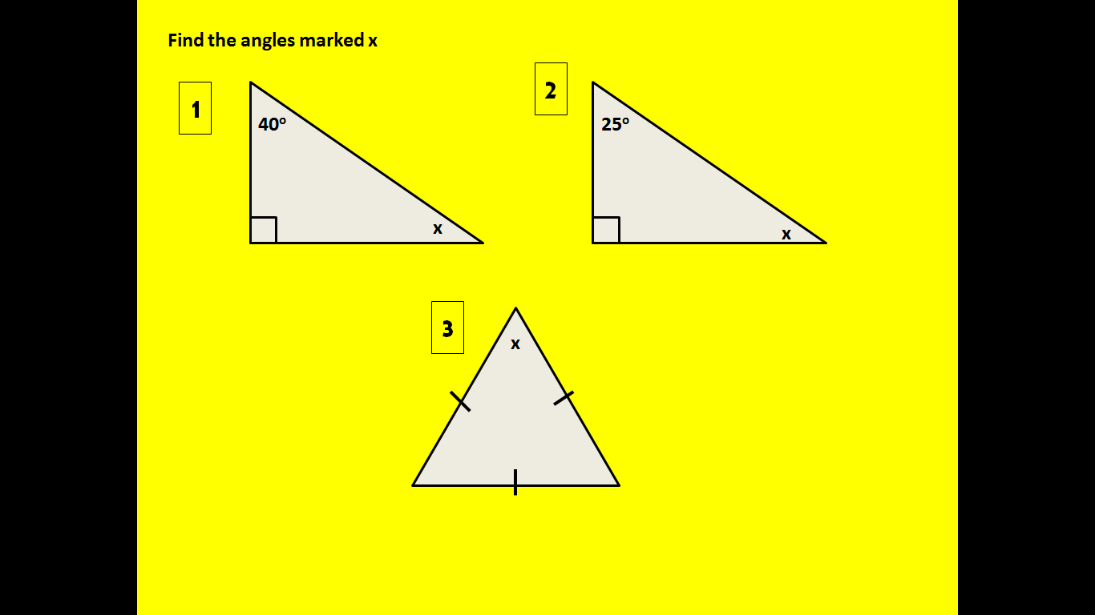
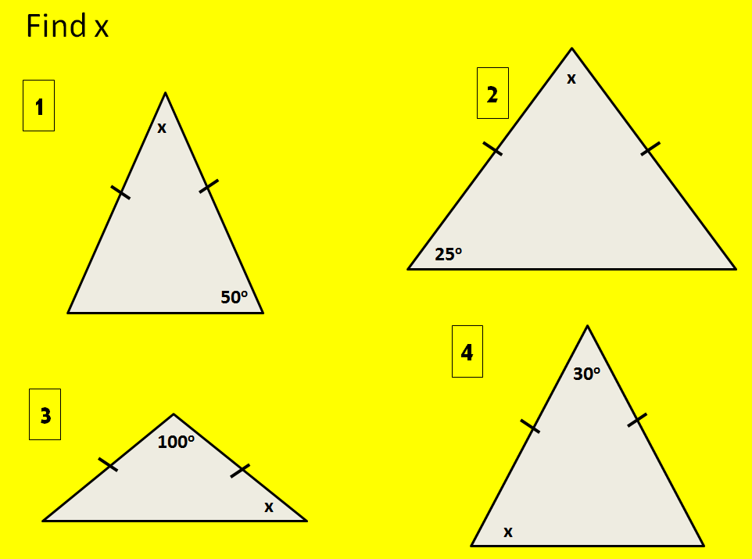
Angles in a triangle
Home

Slide 81
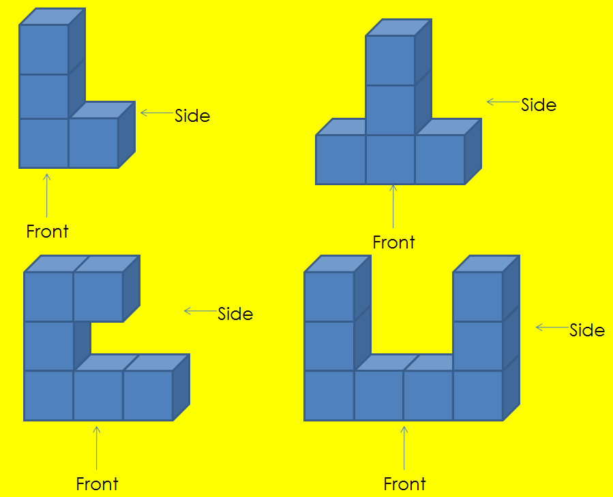
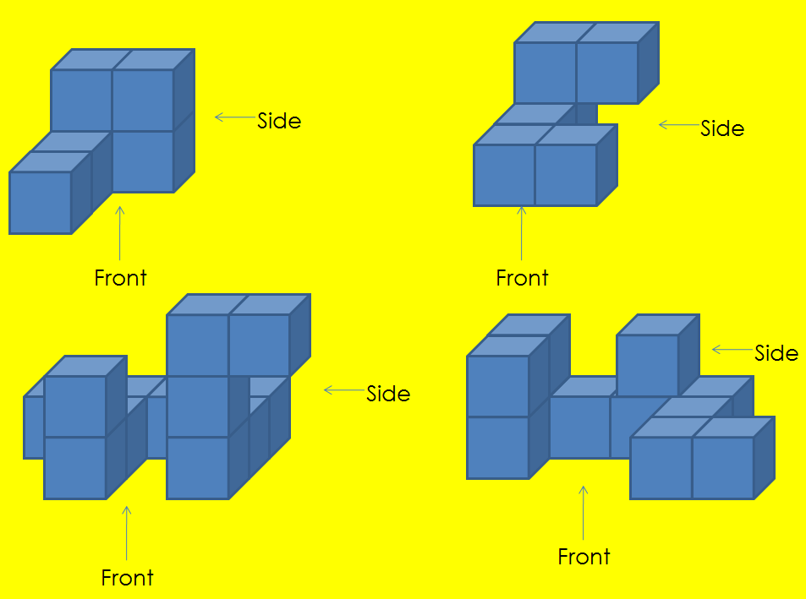
Plans and Elevations
Draw the plan and the front and side elevations for these shapes
Home

Slide 82
Pythagoras
Home
Shape

Slide 83
Mean
Find the mean from these numbers:
5,3,4
10, 11, 1, 7
15, 8, 7, 10
14, 2, 4, 1, 4
7, 8, 5, 10, 4, 2
24, 26, 32, 17, 1
0.2, 0.1, 0. 5, 0.3
20, 9, 3, 8, 8, 8
17, 18, 15, 10, 8, 2, 10
0,0,0,0,0,18
How would you find the:
Mean age of players in a football team
Mean height of a family
Mean number of sweets eaten by boys in a day
Mean number of hours spent watching TV for a pupil each night
Mean number of times someone says “LOL” a day
Write down 3 possible lists of numbers if there are:
4 numbers with a mean of 6
5 numbers with a mean of 8
7 numbers with a mean of 9
Home

Slide 84
Mean, Mode, Median and Range
Which of these could you not find a median for?
Height
Favourite colour
Score in a test
Favourite football team
Find the mean, mode, median and range for these sets of numbers:
5,7,2,8,8
2,12,6,3,2
15,4,11,6,4
20,30,35,15,15
4,7,0,14,0,19,5
2,9,18,12,7,2,6
21,13,15,2,15,3,1
Write 3 different lists of 5 numbers which have a mean of 7.
Write 3 lists of numbers which have a median of 11
Would mode be a good thing to find if we were looking at pupils exact journey time to school? Explain your answer.
Can any of mean, median, mode and range be negative? Explain your answer
Home

Slide 85
Median and Range
Home

Slide 86
Mean from grouped tables
Home

Slide 87
Mean from tables
Home

Slide 88
Drawing Pie charts 1
Home

Slide 89
Drawing Pie Charts 2
Home

Slide 90
Probability as Fractions
I have some counters in a bag. There are 3 blue, 5 red and 2 green. What is the probability I pick out:
A blue
A red
A green
A purple
A blue or red
A red or green
I am picking my socks at random today, I have 4 pairs with stripes on, 10 with spots, 5 with clowns and 1 with maths pictures. What is the probability I will pick out:
Spotty socks
Clown socks
Maths Socks
Clown or spotty socks
Maths or stripe socks
3. I have a pack of card (without jokers) what is the probability I pick:
A Red card
A heart
A Club
A heart or a club
A 2
A King
A picture card
A number card smaller than 6
A number card greater than 6
An even number
An odd number
A red number 3
A black Queen or red Jack
A King of Hearts or a 5
Home

Slide 91
Relative Frequency
Home

Slide 92
Listing Outcomes
If I flip a coin and roll a dice, list all the possible outcomes I could get.
I spin two fair spinners number 1 to 3.
Copy and complete the table to show all the possible outcomes.
When I have breakfast I have a drink and something to eat. The drinks I choose from are tea, coffee and juice and I eat a bagel, toast or cereal. Write down all the different combinations I could have for breakfast.
If I toss 1 coin there are 2 possible outcomes, find the number of outcomes for:
2 coins b. 3 coins c. 4 coins d. X coins
Lucy, Amy and George are going to have their photo taken so they sit in a line:
How many different ways could they order themselves?
Andy joins them, how many different ways could they order themselves now?
Spinner 1 | Spinner 2 | Total
Home

Slide 93
Drawing Bar Charts
Home

Slide 94
Tree Diagrams
A) I have a bag with 20 balls in, there are 13 pink, 7 orange pull a ball out, put it back then pull another.
Draw a tree diagram showing all possible outcomes
Use your tree diagram to find the probability of getting:
2 pink
2 orange,
A pink and an orange.
B) The probability I have toast for breakfast is 0.6, the probability I will miss my bus is completely unrelated to my breakfast choice and is 0.2
What is the probability I will NOT:
Have toast for breakfast
Miss my bus
Draw a tree diagram showing all possible outcomes
Use your tree diagram to find the probability of:
Having toast and missing my bus
Not having toast and missing my bus
Not having toast and not missing my bus
C) I am tossing a coin and rolling a dice:
Draw a tree diagram to show all possible outcomes.
Use your tree diagram to find the probability of:
A head a 3
A tails and a number bigger than 4
A tails with a 3 or a heads with a 1
D) I have some songs on my mp3 player, 4 are rock, 7 are Pop and 11 are Hip Hop. I put my mp3 player on shuffle and listen to 2 songs (it is possible to listen to the same song twice in a row)
Draw a tree diagram to show all the possible outcomes,
Find the probability that I will listen to:
Hip Hop then Pop
Rock twice
A Rock song and a pop song in any order
2 songs which are the same style (rock and rock or pop and pop ect.)
Home

Slide 95
Stem and Leaf Diagrams
Home

Slide 96
Scatter Graphs
Home

Slide 97
The Probability Line
Home

Slide 98
Box and Whisker plots
Home

Slide 99
Mutually Exclusive Events
Home

Slide 100
Sample Space Diagrams
Home

Slide 101
Sampling
Home

Slide 102
Histograms
Home

Slide 103
Drawing Cumulative Frequency Graphs
Home

Slide 104
Reading Pie Charts
How many people are represented by each slice of the pie charts?
Home

Slide 105
Reading Bar Charts
Home

